Slide 1
Design THINKING
Unit 3a
Dr. Lakshmi S,
Dept. of ECE, RIT

Slide 2
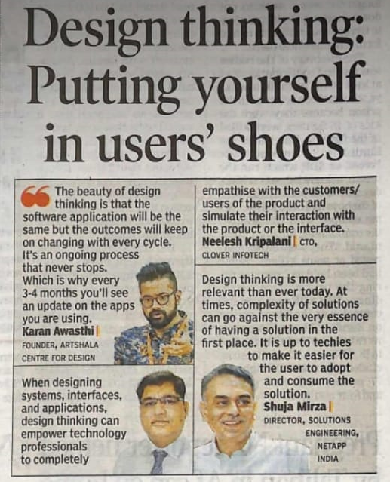

Slide 3
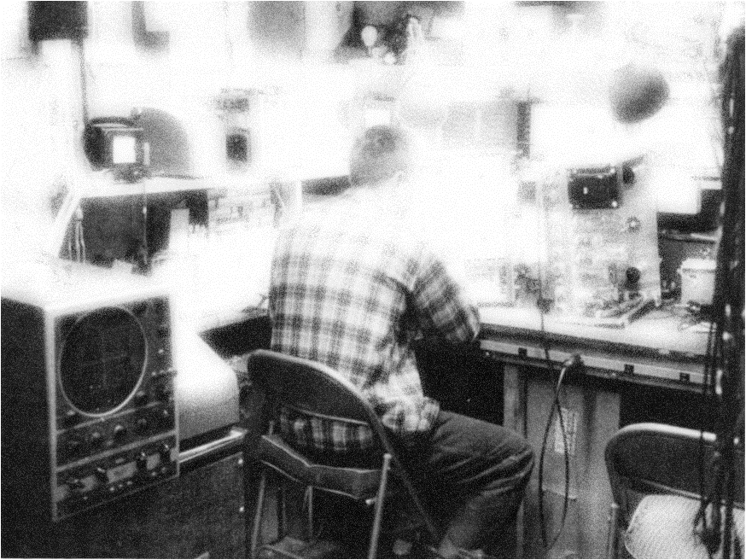
Demystifying creativity
Myth 1: Ideas are generated by lone geniuses
Myth 2: Ideas are generated by lone geniuses
Did you think Thomas Edison sat alone in a garage and thought of solutions?

Slide 4
Demystifying creativity
Truth 1: With practice, anyone can generate good ideas
Truth 2: Good innovators also need a team! And need to stand on the shoulders of giants!
Thomas Edison worked with a team of 40 people in a large-scale research lab

Slide 5
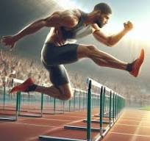
David Kelley quotes
Creative confidence like a muscle which can be strengthened and nurtured through effort and experience,
Design is a sport in which you have to participate.
You need to train like the athletes.

Slide 6
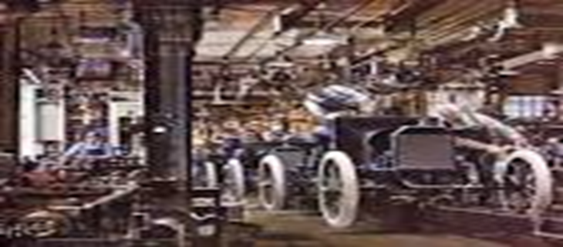
Henry Ford's assembly line in the 1920s revolutionized American manufacturing and made it possible to produce the Model T at a much faster rate
This idea derived from soldiers who used to repair broken rifles and from the meat processing industry which used conveyors for sending the carcasses.
The assembly line had several benefits, including:
Lowering the price of the Model T
Allowing Ford Motor Company to operate 24 hours a day
Providing jobs that almost anyone could do
Providing employment to immigrants
https://www.history.com/this-day-in-history/fords-assembly-line-starts-rolling

Slide 7
Takeaways from the Edison and Ford story
These innovators worked in teams
Their ideas were a culmination of old ideas put forth in a new way.
Collaborative work to generate diverse creative ideas.
Yes these innovators are brilliant but many times their innovations arise from the work and ideas of others who accompanied or preceded them.

Slide 8
Austin Kleon has stated in Steal Like an Artist:
Noting is Completely Original
A person’s creative work is constructed based on the work that came be before it; it is a new mixture of different works or a new version on previous works
Liberate from the pressure and false notion of creating original ideas from nothing

Slide 9

Jeff Bezos Story

Slide 10
Find the predecessor
Volunteer!
One student is to mention a modern day invention, others have to say what were its predecessors, and what theories had to be in place for the invention to come about

Slide 11
Invention: Smartphone
Predecessors:
Landline Telephones:
Before smartphones, the most common communication devices were landline telephones, which used analog signals to transmit voice over a copper wire network.
Mobile Phones (Cell Phones):
The mobile phone evolved from the landline telephone and allowed for wireless voice communication. Early mobile phones were bulky and used analog signals (first-generation, or 1G), and later transitioned to digital signals (2G, 3G).

Slide 12
3D Printing
Predecessor: Traditional Manufacturing (CNC machines, molds)
Traditional manufacturing involved subtracting material from a block or casting it into molds to create products.
Modern Invention: 3D Printing
3D printers create objects layer by layer from digital models, revolutionizing industries from manufacturing to healthcare.

Slide 13
Social Media
Predecessor: Bulletin Boards & Early Internet Communication (IRC, Usenet)
Before social media, early internet users communicated through text-based forums and early online communities.
Modern Invention: Platforms like Facebook, Twitter, Instagram
These platforms enable real-time communication, sharing of photos, videos, and thoughts, and global interaction.

Slide 14
Blockchain Technology
Predecessor: Traditional Banking and Centralized Systems
Banking systems relied on centralized entities like banks to validate transactions and manage ledgers.
Modern Invention: Blockchain and Cryptocurrencies (e.g., Bitcoin)
A decentralized digital ledger technology that allows secure and transparent transactions without intermediaries, enabling cryptocurrencies and smart contracts.

Slide 15
Wireless Internet (Wi-Fi)
Predecessor: Dial-up Internet / Wired Broadband
Early internet connections relied on dial-up modems, which used phone lines for internet access, and later on broadband via cables.
Modern Invention: Wi-Fi and 5G
Wireless internet connectivity allows fast data transmission over short distances, enabling mobile devices and laptops to connect to the internet anywhere.

Slide 16
Virtual Reality (VR)
Predecessor: Simulators and Early Computer Graphics
Before VR, flight simulators and arcade machines provided immersive experiences, but they were typically limited to specific environments.
Modern Invention: Virtual Reality (e.g., Oculus Rift, HTC Vive)
Immersive VR technology creates 3D environments where users can interact with a digital world in a way that feels real, transforming entertainment, training, and healthcare.

Slide 17
Drones
Predecessor: Remote-Controlled Airplanes and Helicopters
Before drones, remote-controlled models were used for hobbies and military purposes but lacked autonomy.
Modern Invention: Commercial Drones (e.g., DJI Phantom)
Drones are equipped with cameras, sensors, and autonomous navigation systems for use in fields like delivery, photography, agriculture, and military surveillance.

Slide 18
IDEO – Shopping cart challenge
www.youtube.com/watch?v=M66ZU2PCIcM

Slide 19
IDEO – Shopping cart challenge
PRINCIPLES
One conversation at a time
Stay focused
Encourage wild ideas
Defer(postpone) judgment
Build on the idea of others

Slide 20
Pre-Brainstorming: Mindset, Warm-ups
Practical Optimism: Positive thinking + Beneficial action = Good results
Knowing that getting stuck is ok! (Activity of the circles)
Help improvise others’ ideas: Try not to say ‘Yes, but’.. Try saying ‘Yes, and’

Slide 21
Getting Stuck with 30 Circle Exercise
Step 1: Each participant gets one 30 Circles sheet of paper and something to draw with.
Step 2: Turn as many of the blank circles as possible into recognizable objects in three minutes (think clock faces, billiard balls, etc.)
Step 3: Compare results on following parameters:
Look for the quantity or fluency of ideas
How many people filled in ten, fifteen, twenty or more circles? (Typically most people don’t finish.)
Next, look for diversity or flexibility in ideas. See if the ideas are derivative (a basketball, a baseball, a volleyball) or distinct (a planet, a cookie, a happy face). Did anyone “break the rules” and combine circles (a snowman or a traffic light)?
Were the rules explicit, or just assumed?

Slide 22
Divergent thinking
Quantity better than Quality: Do not try to fine tune your idea. Work on getting many ideas
Encourage wild ideas: Initially it might look pointless, but with practice, you’ll be surprised!

Slide 23
Building on ideas
Build by plussing on ideas of others: Do not use their ideas/ solutions as such. See how you can improve or customize them.
Share your opinions with others: Use sticky notes (or such) to share your opinions
Getting unstuck: Create subsidiary ‘how-might-we’ question or reframe problem statement.

Slide 24
Convergent thinking:
When you have enough ideas that appropriately addresses the problem statement, choose the best idea
Criteria: Most likely to make user happy. Most likely to work. Most likely to be interesting.
Getting unstuck: Create subsidiary ‘how-might-we’ question or reframe problem statement.

Slide 25
Make a blueprint
Can be technical drawings or strategic plan, a website, a flow chart, a story board, or so on.

Slide 26
Take home activity
In a sheet (for submission) write down different ideas for DIY mechanical games inspired by video games. Then converge to one idea and bring a blue print.
https://youtu.be/BWFtC0GKWf0

Slide 27
Improvisional theatre
Start
Story line
Link up with made up thread of thought
Dialogues ( can be funny too)
Dialogues( could be teaching lessons too )

Slide 28
Party Planner
One person starts with the theme
Others keep on giving ideas to make it interesting
Say yes to every idea not Yes…But..

Slide 29
Disruptive Thinking
Looking at an idea or an object and coming up with an entirely different way to achieve the same end.
Examples of businesses based on disruptive thinking
10 real-world examples of disruptive innovation
Smartphones. Smartphones revolutionized communication by transforming how we connect, forcing traditional phone manufacturers and telecom companies to adapt. ...
Amazon. ...
Healthcare. ...
Uber. ...
Netflix. ...
Airbnb. ...
Tesla. ...
Spotify.

Slide 30
Blackberry phone : leading market share till 2007
Then came Apple’s Iphone: no key boards, great camera, amazing internet experience.
Created by Applie’s Design engineers who described the experience as “harrowing”and a “soup of misery”

